Slide 1

Advanced Data Structures-JAVA
By

Slide 2
Wrapper Classes:
A Wrapper class in Java is a class whose object wraps or contains primitive data types.
When we create an object to a wrapper class, it contains a field and in this field, we can store primitive data types.
It also include methods to unwrap the objects back into the primitive data types. It is one of the classes provided in the java.lang package and all of the primitive wrapper classes in Java are immutable.
Advantages of Wrapper Classes
Collections allowed only object data.
On object data we can call multiple methods compareTo(), equals(), toString()
Cloning process only objects
Object data allowed null values.
Serialization can allow only object data.

Slide 3
Why Wrapper Classes in Java?
Whenever the primitive types are required as an object, wrapper classes can be used. Wrapper classes also include methods to unwrap the object and give back the primitive data type.
In java.util package, the classes handle only objects and that's why in this case wrapper class helps.
In the Collection framework, Data Structures such as ArrayList stores only the objects and not the primitive types.
For the methods that support object like creation from other types such as String.
Wrapper classes are also used for synchronization in multithreading. As objects are needed to achieve the synchronization process where we ensure that the shared resource will be used by only one thread at a time.

Slide 4
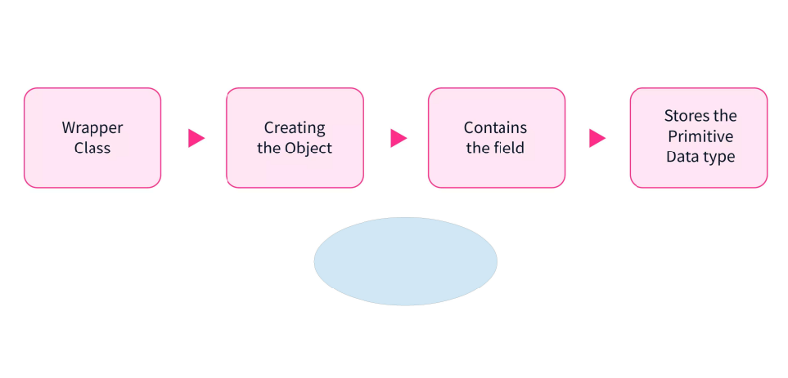

Slide 5
Autoboxing:
Autoboxing is when the Java compiler performs the automatic conversion of the primitive data types to the object of their corresponding wrapper classes.
For example, converting an int to Integer, a double to Double, etc.
The Java compiler applies autoboxing when a primitive value is: Passed as a parameter to a method that expects an object of the corresponding wrapper class.
Assigned to a variable of the corresponding wrapper class

Slide 6
Unboxing:
It is just the opposite process of autoboxing.
Unboxing is automatically converting an object of a wrapper type (Integer, for example) to its corresponding primitive (int) value.
The Java compiler applies unboxing when an object of a wrapper class is: Passed as a parameter to a method that expects a value of the corresponding primitive type.
Assigned to a variable of the corresponding primitive type.

Slide 7
Method Description
typeValue() Converts the value of a Numeric object such as Integer, Float or Double to the specified primitive data type and returns the value
compareTo() Compares this Number object to the argument passed
equals() Determines whether this Number object is equal to the argument
valueOf() Returns an Integer object holding the value of the specified primitive data type value.
toString() Returns a String object representing the value of specified Integer type argument.
parseInt() Returns an Integer type value of a specified String representation.
decode() Decodes a String into an integer min() Returns the smaller value after comparison of the two arguments.
max() Returns the larger value after comparison of the two arguments.
round() Returns the closest round off long or int value as per the method return type.

Slide 8
What is Generics?
Collections can store Objects of any Type
Generics restricts the Objects to be put in a collection
Generics ease identification of runtime errors at compile time

Slide 9
How is Generics useful?
Consider this code snippet
List v = new ArrayList();
v.add(new String("test"));
Integer i = (Integer)v.get(0); // Runtime error . Cannot cast from String to Integer
This error comes up only when we are executing the program and not during compile time.

Slide 10
How does Generics help?
The previous snippet with Generics is
List<String> v = new ArrayList<String>();
v.add(new String("test"));
Integer i = v.get(0); // Compile time error. Converting String to Integer
The compile time error occurs as we are trying to put a String and convert it to Integer on retrieval.
Observe we don’t have to do an explicit cast when we invoke the get method.
We can also use interfaces in Generics

Slide 11
What is an algorithm?
An algorithm is a list of steps (sequence of unambiguous instructions ) for solving a problem that transforms the input into the output.
problem
algorithm
input
“computer”
output
Notes:
11

Slide 12
Difference between Algorithm and Program
Algorithm | Program
Algorithm is finite | Program need not to be finite
Algorithm is written using natural language or algorithmic language | Programs are written using a specific programming language

Slide 13
PROPERTIES OF AN ALGORITHM
Input: An algorithm takes zero or more inputs
Output: An algorithm results at least one output
Definiteness: Each instruction is clear and unambiguous.
Finiteness: An algorithm must terminate after a finite number of steps.
Effectiveness: Every instruction must be basic enough to be carried out , in principle, by a person using pen and paper. All operations can be carried out in a finite amount of time

Slide 14
Ex: Algorithm for addition of two numbers
Step 1: Start
Step 2: Declare variables num1, num2 and sum.
Step 3: Read: num1,num2.
Step 4: Add num1 and num2 and assign the result to sum.
sum←num1+num2
Step 5: Write: sum
Step 6: Stop

Slide 15
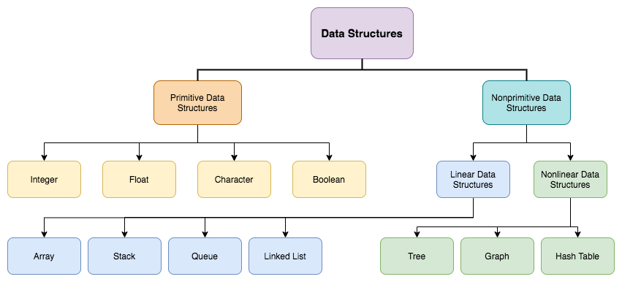
Types of Data Structures

Slide 16
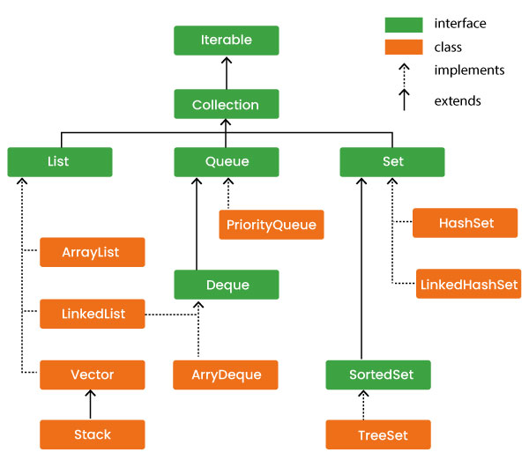
Collection Hierarchy

Slide 17
ADT ABSTRACT DATA TYPE
Abstract Data type (ADT) is a type (or class) for objects whose behaviour is defined by a set of values and a set of operations.
The definition of ADT only mentions what operations are to be performed but not how these operations will be implemented.
It does not specify how data will be organized in memory and what algorithms will be used for implementing the operations.
It is called “abstract” because it gives an implementation-independent view.

Slide 18
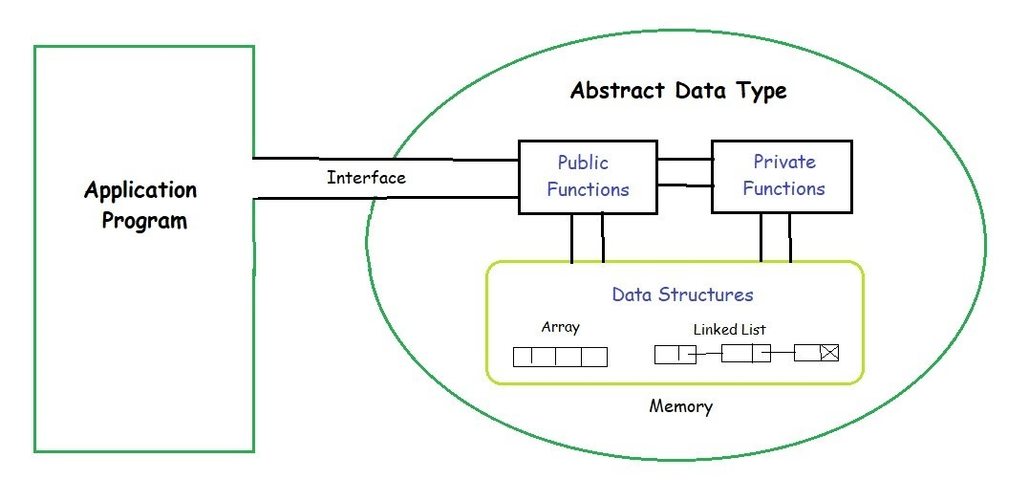
ADT

Slide 19
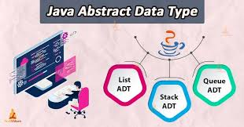
ADT
Types of ADT’s:
List ADT
Stack ADT
Queue ADT
Features:
Abstraction.
Modularity.
Data Structure Independence.
Robust
Encapsulation.

Slide 20
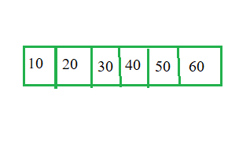
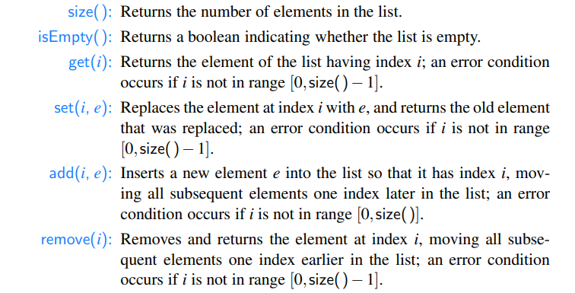
List ADT
The data is generally stored in key sequence in a list.

Slide 21
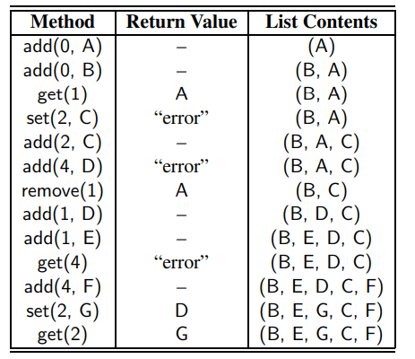
Example of List ADT

Slide 22
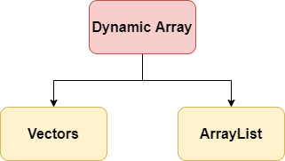
Dynamic Arrays:
The dynamic array is a variable size list data structure.
It grows automatically when we try to insert an element if there is no more space left for the new element.
It allows us to add and remove elements.
It allocates memory at run time using the heap.
It can change its size during run time. Dynamic arrays are two types:

Slide 23
ArrayList:
An ArrayList class is a dynamic array, which is present in the java. util package.
While built-in arrays have a fixed size, ArrayListcan change their size dynamically.
Elements can be added and removed from an ArrayList whenever there is a need, helping the user with memory management.
Points to be note:
Java Array List class can contain duplicate elements.
Java Array List class maintains insertion order.
Java Array List allows random access because array works at the index basis.

Slide 24
Creating Array List:
Array List is created like arrays as follows:
syntax:
ArrayList<Type> arrayList= new ArrayList<>();
By defining size.
ArrayList<Type> arrayList= new ArrayList<>(3);

Slide 25
Vector List:
The Vector class is used to create a generic dynamic array known as vectors that can hold objects of any type and any number.
It is contained in java.util package. Arrays can be easily implemented as vectors.
Advantage of using Vectors:
It is convenient to use vectors to store objects.
A vector can be used to store a list of objects that may vary in size.
We can add and delete objects from the list.

Slide 26
Creating vectors:
Vectors are created like arrays as follows:
Syntax:
Vector <type> vector_name = new Vector <type> (); //declaring without size
Vector <type> vector_name = new Vector <type> (3);// declaring with size

Slide 27
Amortized Analysis
Amortized time complexity provides a way to average out the time taken by a sequence of operations on a data structure, rather than focusing on individual operations.
Dynamic Array Operations:
Append Operation: Adding an element to the end of the array.
Resize Operation: Increasing the size of the array when it's full.

Slide 28
Amortized Analysis:
Despite occasional resize operations taking longer (O(n)), the average time complexity of append operations remains constant (O(1)).
This is because the cost of resize operations is spread out over a sequence of append operations, resulting in an amortized time complexity of O(1) per append.
Benefits of Amortized Analysis:
Provides a more accurate understanding of the performance of dynamic arrays by considering the cumulative effect of operations.
Allows developers to make informed decisions about the choice of data structure based on their performance characteristics

Slide 29
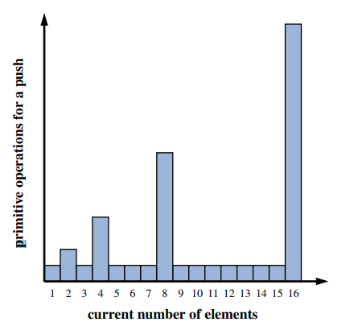

Slide 30
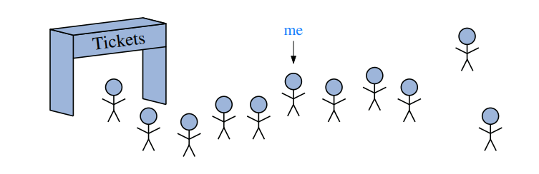
Positional Lists
Integer indices are effective for array-based sequences but not suitable for describing positions within linked lists.
Numeric indices lack efficiency for navigating to an element within a linked list, as it requires sequential traversal from the beginning or end.
Additionally, indices fail to provide a stable abstraction for describing a local view of a position due to frequent changes caused by insertions or deletions.

Slide 31
Positions
To provide a general abstraction for the location of an element within a structure.
A position ADT supports a single method: getElement(), which returns the element stored at that position.
A position p, which is associated with some element e in a list L, does not change, even if the index of e changes in L due to insertions or deletions elsewhere in the list. Nor does position p change if we replace the element e stored at p with another element.
The only way in which a position becomes invalid is if that position (and its element) are explicitly removed from the list

Slide 32
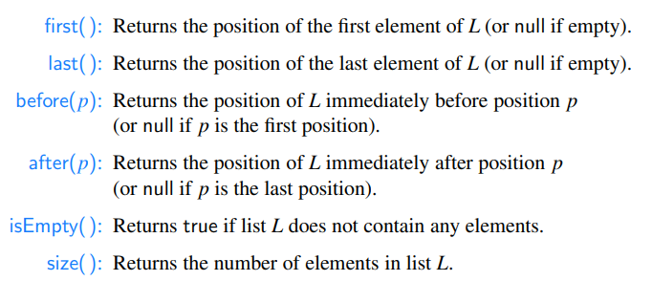
Positional List Abstract Data Type

Slide 33
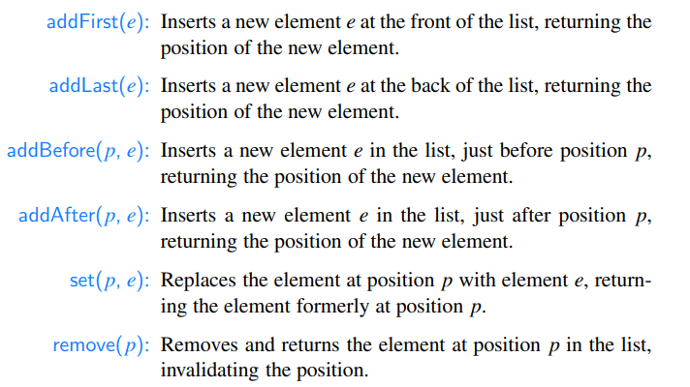
Updated Methods of a Positional List

Slide 34
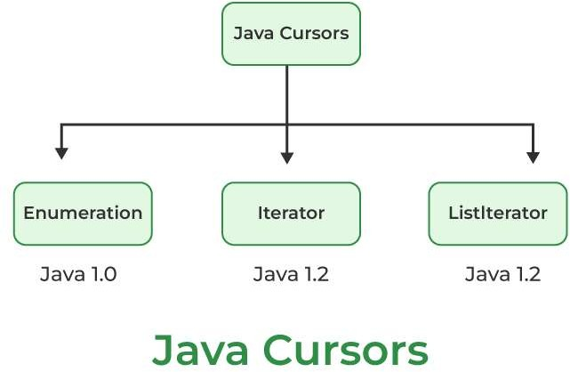
Iterators
A Java Cursor is an Iterator, which is used to iterate or traverse or retrieve a Collection or Stream object’s elements one by one.

Slide 35
1. Iterator
Iterators in Java are used in the Collection framework to retrieve elements one by one. It is a universal iterator as we can apply it to any Collection object. By using Iterator, we can perform both read and remove operations. It is an improved version of Enumeration with the additional functionality of removing an element.
Syntax:
Iterator itr = c.iterator();

Slide 36
Methods of Iterator Interface in Java
The iterator interface defines three methods as listed below:
hasNext(): Returns true if the iteration has more elements. public boolean hasNext();
next(): Returns the next element in the iteration. It throws NoSuchElementException if no more element is present.
public Object next();
remove(): Removes the next element in the iteration. This method can be called only once per call to next().
public void remove();
Note: remove() method can throw two exceptions namely as follows:

Slide 37
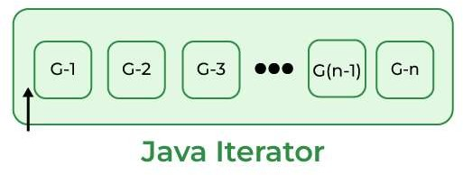
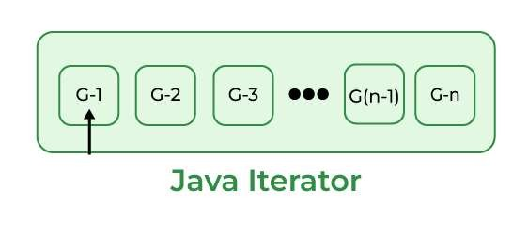
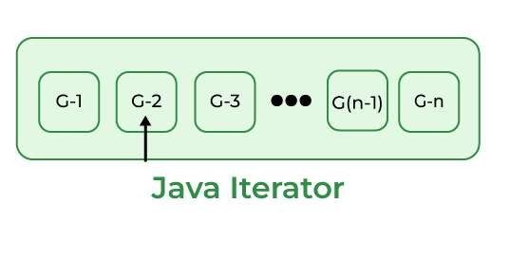
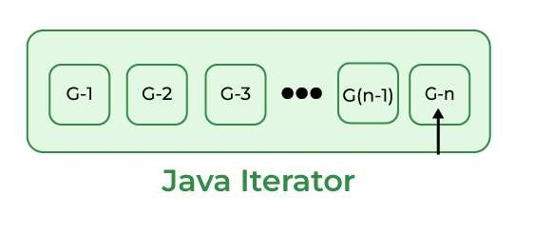
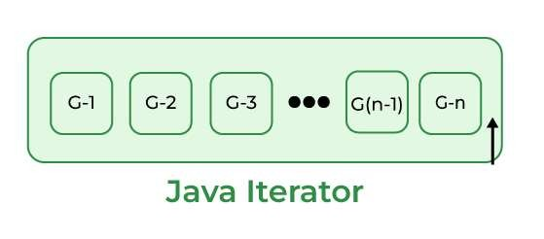
How Does Java Iterator Work Internally?

Slide 38
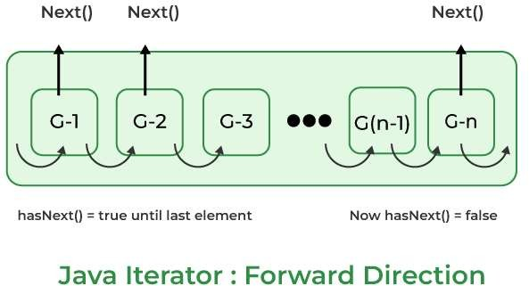

Slide 39
Advantages of Java Iterator
We can use it for any Collection class.
It supports both READ and REMOVE operations. It is a Universal Cursor for Collection API. Method names are simple and easy to use them.
Limitations of Java Iterator
Also, there are certain limitations of Iterator which are listed as follows:
In CRUD Operations, it does NOT support CREATE and UPDATE operations.
It supports only Forward direction iteration that is a Uni-
Directional Iterator.
Compare to Spliterator, it does NOT support iterating elements parallel which means it supports only Sequential iteration.
Compare to Spliterator, it does NOT support better performance
to iterate large volumes of data.

Slide 40
2. Enumeration
It is an interface used to get elements of legacy collections(Vector, Hashtable). Enumeration is the first iterator present from JDK 1.0, rests are included in JDK 1.2 with more functionality. Enumerations are also used to specify the input streams to a SequenceInputStream. We can create an Enumeration object by calling elements() method of the vector class on any vector object

Slide 41
There are two methods in the Enumeration interface namely :
public boolean hasMoreElements(): This method tests if this enumeration contains more elements or not.
public Object nextElement(): This method returns the next element of this enumeration. It throws NoSuchElementException if no more element is present

Slide 42
Similarities between Java Enumeration and Iterator
Both are Java Cursors.
Both are used to iterate a Collection of object elements one by one. Both support READ or Retrieval operation.
Both are Uni-directional Java Cursors which means support only Forward Direction Iteration.

Slide 43
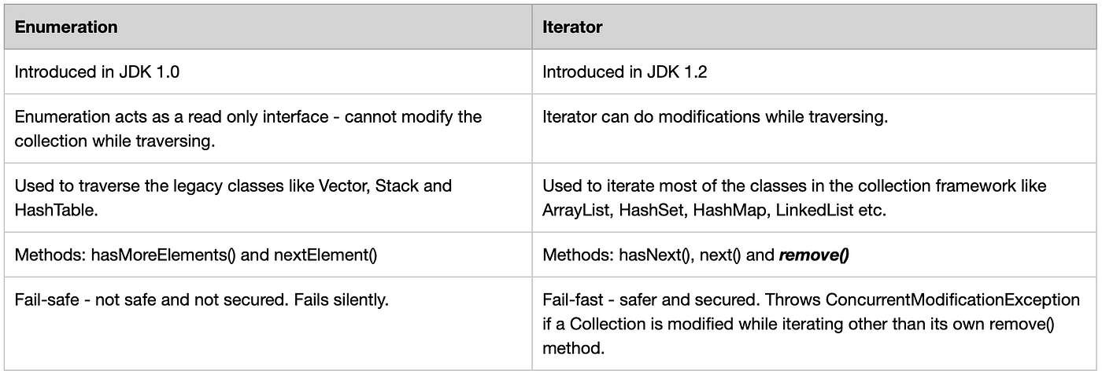

Slide 44
3. ListIterator
It is only applicable for List collection implemented classes like ArrayList, LinkedList, etc. It provides bi-directional iteration.
ListIterator must be used when we want to enumerate elements of
List. This cursor has more functionality(methods) than iterator. ListIterator object can be created by calling listIterator() method present in the List interface.
Syntax
ListIterator ltr = l.listIterator();

Slide 45
1. Forward direction
hasNext(): Returns true if the iteration has more elements
public boolean hasNext();
next(): Same as next() method of Iterator. Returns the next element in the iteration.
public Object next();
nextIndex(): Returns the next element index or list size if the list iterator is at the end of the list.
public int nextIndex();

Slide 46
2. Backward direction
hasPrevious(): Returns true if the iteration has more elements while traversing backward.
public boolean hasPrevious();
previous(): Returns the previous element in the iteration and can throw NoSuchElementException if no more element present.
public Object previous();
previousIndex(): Returns the previous element index or -1 if the list iterator is at the beginning of the list,
public int previousIndex();

Slide 47
3. Other Methods
remove(): Same as remove() method of Iterator. Removes the next element in the iteration.
public void remove();
set(Object obj): Replaces the last element returned by next() or previous() with the specified element.
public void set(Object obj);
add(Object obj): Inserts the specified element into the list at the position before the element that would be returned by next()
public void add(Object obj);

Slide 48
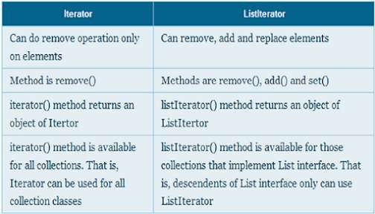

Slide 49
Stacks:
A stack is a data structure that follows the Last-In, First-Out (LIFO) principle.
Elements are inserted and removed from the top of the stack.
The fundamental operations are "push" to add an item to the top of the stack and "pop" to remove the top item.
Stacks find applications in various programming tasks, including function calls, expression parsing,.

Slide 50
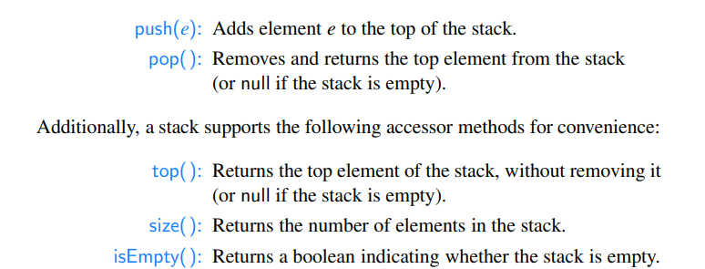
Stack Abstract Data Type

Slide 51
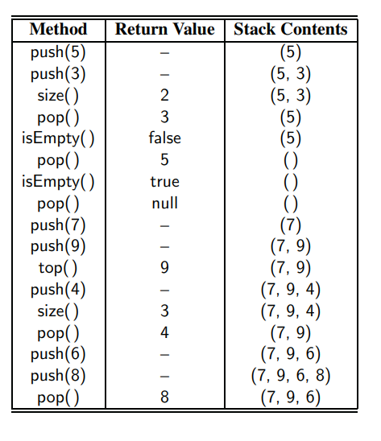
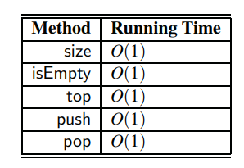
TIME COMPLEXITY IN STACK USING ARRAYS.

Slide 52
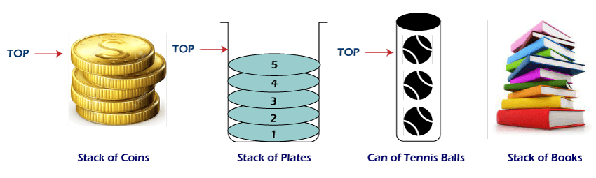
Applications of Stack:

Slide 53
Algebraic Expression
An algebraic expression is a legal combination of operands and the operators.
Operand is the quantity (unit of data) on which a mathematical operation is performed.
Operand may be a variable like x, y, z or a constant like 5, 4,0,9,1 etc.
Operator is a symbol which signifies a mathematical or logical operation between the operands. Example of familiar operators include +,-,*, /, ^
Considering these definitions of operands and operators now we can write an example of expression as x+y*z.

Slide 54
Infix, Postfix and Prefix Expressions
INFIX: From our schools times we have been familiar with the expressions in which operands surround the operator,
e.g. x+y, 6*3 etc this way of writing the Expressions is called infix notation.
POSTFIX: Postfix notation are also Known as Reverse Polish Notation (RPN).
They are different from the infix and prefix notations in the sense that in the postfix notation, operator comes after the operands,
e.g. xy+, xyz+* etc.
PREFIX: Prefix notation also Known as Polish notation.In the prefix notation, as the name only suggests, operator comes before the operands,
e.g. +xy, *+xyz etc.

Slide 55
Operator Priorities
How do you figure out the operands of an operator?
a + b * c
a * b + c / d
This is done by assigning operator priorities.
priority(*) = priority(/) > priority(+) = priority(-)
When an operand lies between two operators, the operand associates with the operator that has higher priority.

Slide 56
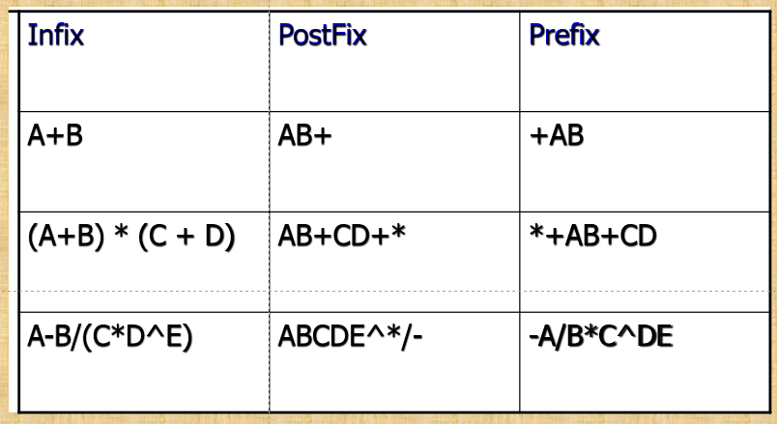
Examples of infix to prefix and postfix

Slide 57
Algorithm for Infix to Postfix
Examine the next element in the input.
If it is operand, output it.
If it is opening parenthesis, push it on stack.
If it is an operator, then
If stack is empty, push operator on stack.
If the top of stack is opening parenthesis, push operator on stack
If it has higher priority than the top of stack, push operator on stack.
Else pop the operator from the stack and output it, repeat step 4.
If it is a closing parenthesis, pop operators from stack and output them until an opening parenthesis is encountered. pop and discard the opening parenthesis.
If there is more input go to step 1
If there is no more input, pop the remaining operators to output.

Slide 58
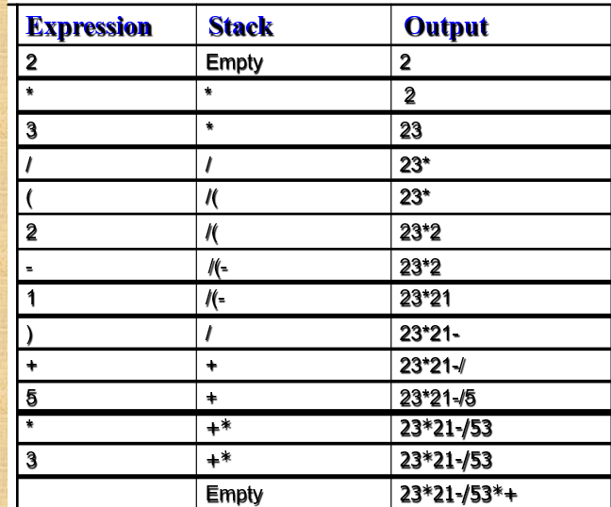
Suppose we want to convert 2*3/(2-1)+5*3 into Postfix form,
The Postfix Expression is 23*21-/53*+

Slide 59
Converting Exercise
Convert the following infix expression to postfix using stack:
1. A + (B /C)
2. (( A – ( B + C)) * D) / (E +F)

Slide 60
Infix To Prefix Expression

Slide 61
Reverse the input string.
Iterate through each character in the input:
If it's an operand, add it to the output.
If it's a closing parentheses, push it onto the stack.
If it's an operator:
If the stack is empty or the top of the stack is a closing parentheses, push the operator onto the stack.
If the operator has the same or higher priority than the top of the stack, push it onto the stack.
Otherwise, pop operators from the stack and add them to the output until a lower priority operator is encountered, then push the current operator onto the stack.
If it's an opening parentheses, pop operators from the stack and add them to the output until a closing parentheses is encountered, then discard the closing parentheses.
Unstack the remaining operators and add them to the output.
Reverse the output string.

Slide 62
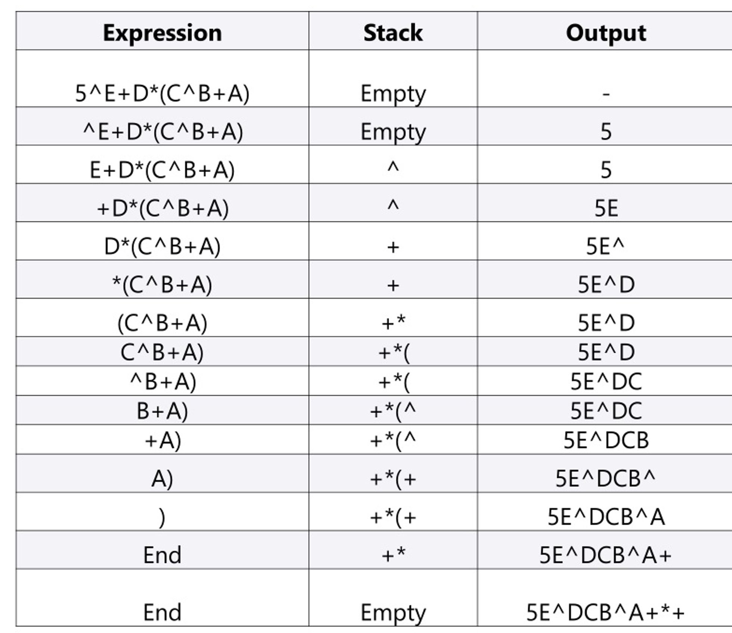
INFIX TO PREFIX EXPRESSIONS
Use this Infix Expression,
(A+B^C)*D+E^5

Slide 63
Converting Exercise
Convert the following infix expression to pretfix using stack:
1. A + (B /C)
2. (( A – ( B + C)) * D) / (E +F)

